Slide 1

CloudShare – A Cloud-Native Multimedia Sharing Platform
A scalable web-based multimedia sharing solution using Microsoft Azure
Student id: 10289130
Module: COM682

Slide 2
Technical Problem & Scalability challenges
Traditional apps struggle with traffic spikes, storage limits, and single points of failure.
Cloud-native design solves these: auto-scaling, pay-as-you-go, high availability, managed services.

Slide 3
2. Proposed Solution Overview
Cloud-native web app for uploading/viewing multimedia.
Files in Blob Storage, metadata in SQL/Cosmos DB.
Backend exposed via REST APIs, frontend is static web app.

Slide 4
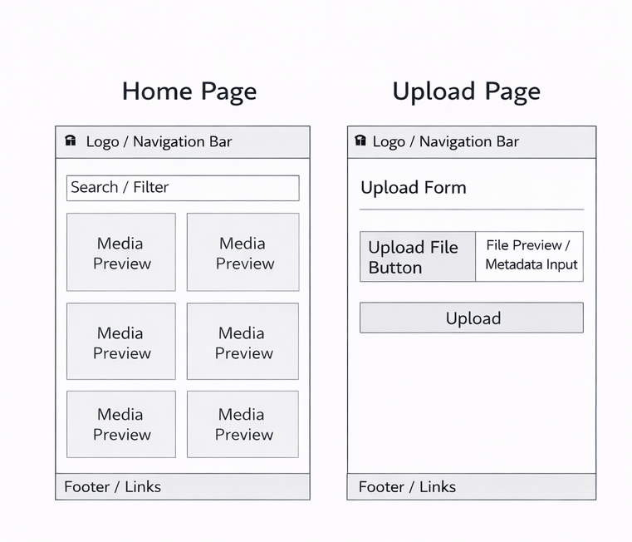
3. Page wireframes
Home Page, Upload Page, Media Gallery
Simple layout, interactive with backend

Slide 5
4. Frontend design
HTML/CSS/JS hosted on Azure Static Web Apps or Blob Storage.
Communicates via REST API with backend.
Benefits: scalable, low cost, CDN support.

Slide 6
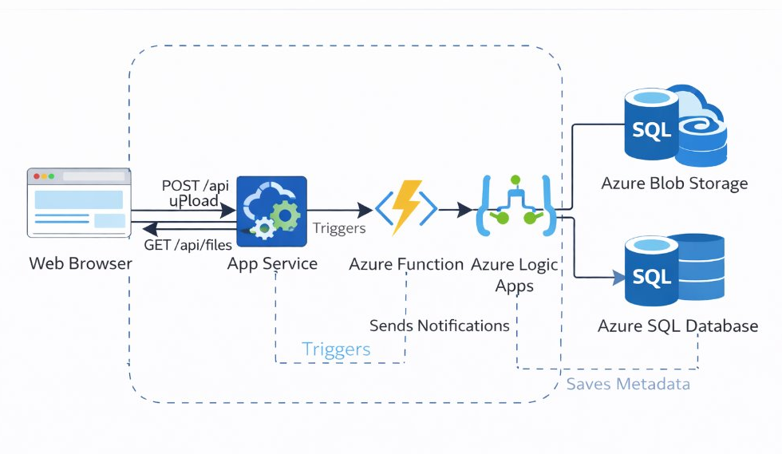
5. Cloud Architecture Diagram
This cloud architecture illustrates a scalable, cloud-native multimedia sharing platform built on Microsoft Azure. Users interact with the web application through a browser, which communicates with Azure App Service to handle HTTP requests. When a user uploads or retrieves media, the request is processed by Azure Functions and orchestrated using Azure Logic Apps to manage workflow automation. Multimedia files are securely stored in Azure Blob Storage, ensuring scalable and cost-efficient binary data storage, while associated metadata is stored in Azure SQL Database for structured data management. This layered architecture separates the presentation, compute, and storage components, improving scalability, maintainability, and performance. The design leverages serverless and managed Azure services to ensure automatic scaling, high availability, and reduced operational overhead, making the solution efficient and cloud-native by design.

Slide 7
6. Compute Layer Design
Backend logic handled by Azure Functions or App Service.
Stateless, auto-scaling, reduces operational costs.

Slide 8
7. Storage Layer Design
Azure Blob Storage for media: scalable, secure, lifecycle policies.
Optional: Azure CDN for faster delivery.

Slide 9
8. Database Design
Relational: Azure SQL → Users, MediaFiles, UploadLogs
NoSQL: Cosmos DB → JSON structure
Metadata stored for users and media
Table examples included in slide notes

Slide 10
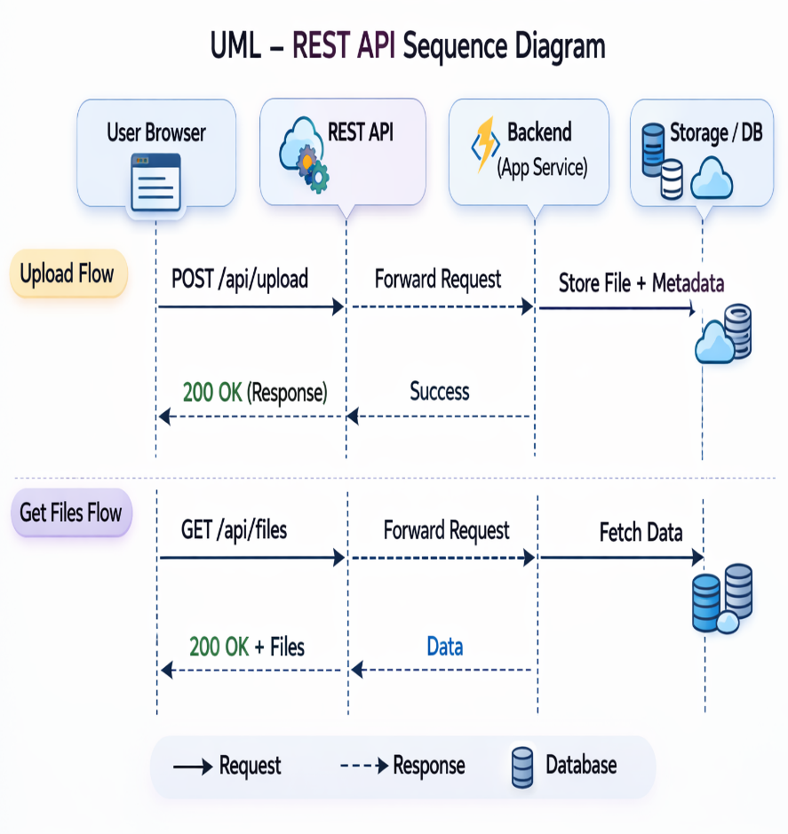
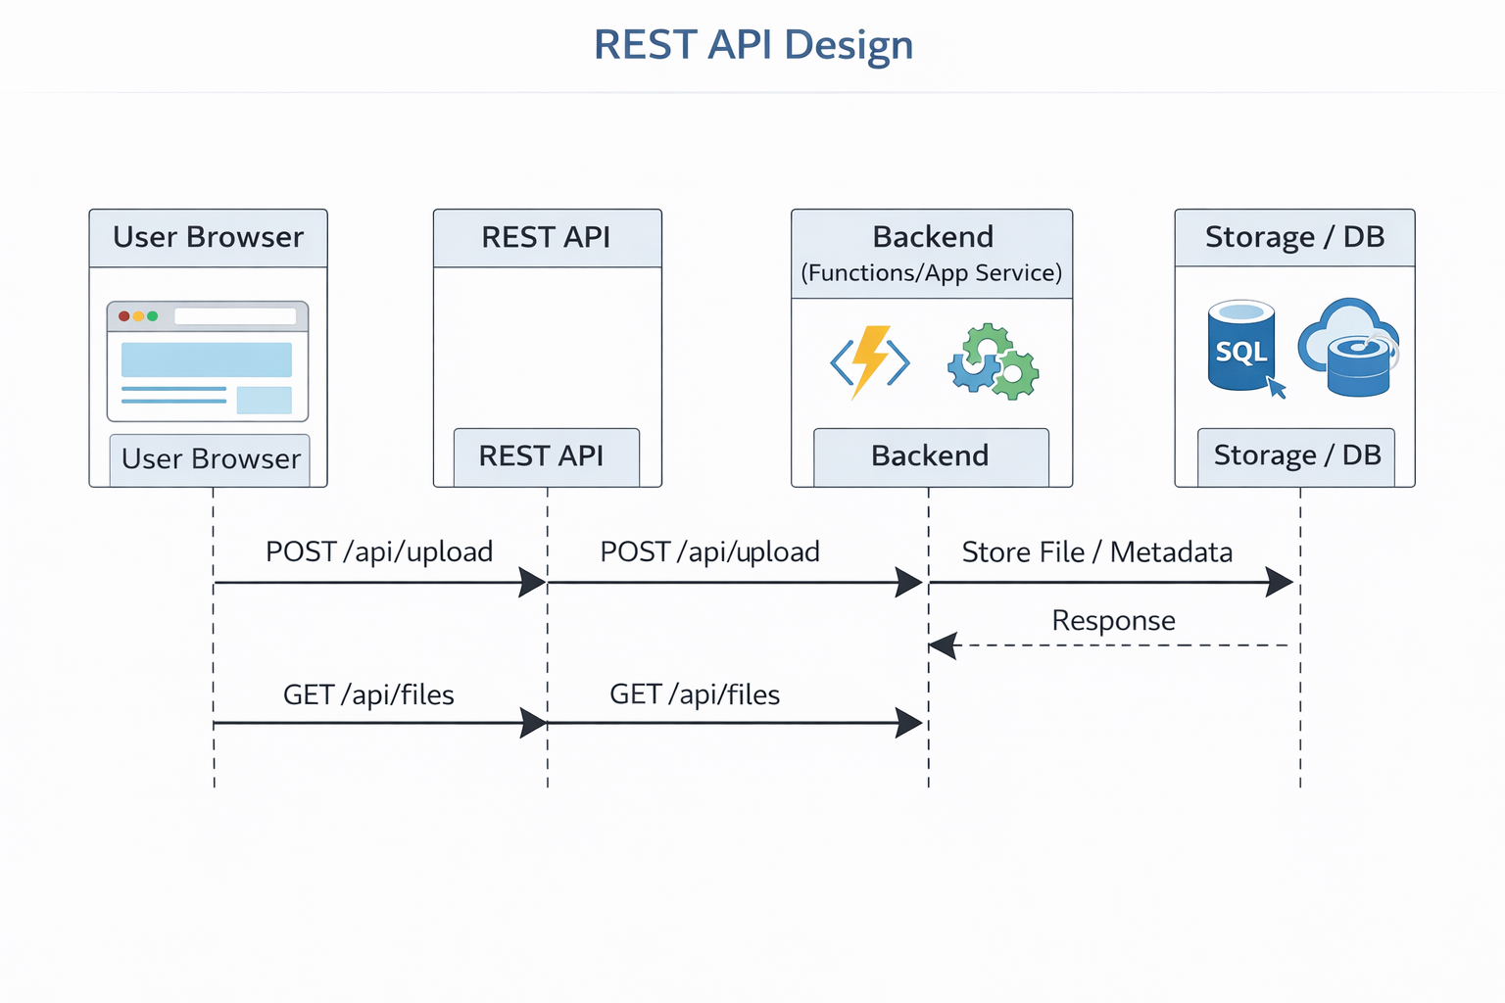
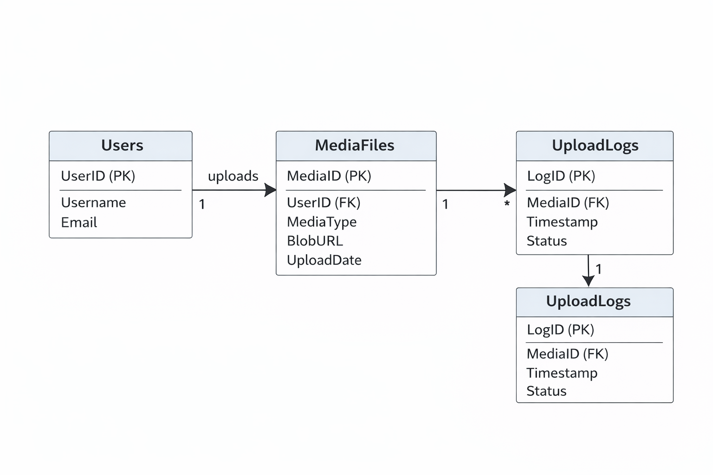
10. REST API Design, UML- REST API Sequence and ERD Diagram
ERD Diagram

Slide 11
11. Advanced Features
Auto-scaling backend : Automatically adjusts compute resources based on traffic to ensure consistent performance and cost efficiency.
Azure CDN : Delivers multimedia content faster by caching and distributing it across global edge locations.
Blob Storage lifecycle policies : Automatically moves or deletes files based on age to optimise storage costs.
Serverless compute : Executes backend logic on demand without managing servers, improving scalability and reducing overhead
Role-based access control (RBAC) : Restricts system access based on user roles to enhance security and governance.
Monitoring & alerts : Continuously tracks system health and sends alerts to quickly detect and resolve issues

Slide 12
12. Scalability Assessment
Frontend: CDN & static hosting → millions of users
The frontend is hosted as static files (HTML, CSS, JS) and delivered through a CDN (Content Delivery Network).
CDNs distribute content across global servers.
Users get content from the nearest location → faster load times.
Since static files don’t require heavy server processing, they can easily support millions of users simultaneously.
Backend: Functions/App Service → auto-scale horizontally
The backend runs on cloud services like serverless Functions or App Services.
Horizontal scaling means adding more instances of the app when traffic increases.
The system automatically creates or removes instances based on demand.
This ensures performance stays stable even during traffic spikes.
Storage: Blob Storage → unlimited
Blob Storage is used for files like images, documents, videos, etc.
Designed to store massive amounts of unstructured data.
It scales automatically as more data is added.
No need to manage servers — storage grows with your application.
Database: SQL/Cosmos DB → scalable vertically & horizontally
The database handles structured data.
Vertical scaling = increasing CPU, RAM, or performance of a single database instance.
Horizontal scaling = distributing data across multiple servers (sharding/partitioning).
This ensures the database can handle both larger data volumes and higher user traffic.

Slide 13
13. Limitations, Ethics & Improvements
Limitations
The system may face higher operational costs, serverless cold-start delays, and network latency, which can affect response time and overall performance during peak usage.
Ethics
It must protect user privacy, comply with GDPR and data protection laws, and ensure proper copyright and content ownership handling.
Improvements
Future upgrades can include AI-based content moderation, enhanced encryption for stronger security, and global replication to improve availability and reduce latency worldwide.

Slide 14
14. Conclusion
Cloud-native solution = scalable, reliable, cost-efficient
Azure services integrate frontend, backend, storage, and DB
Commercially viable, extensible for future features

Slide 15
18. References:
Microsoft Azure (2024) Azure Blob Storage documentation. Available at: https://learn.microsoft.com/en-us/azure/storage/blobs/ (Accessed: 6 February 2026).
Microsoft Azure (2024) Azure Functions documentation. Available at: https://learn.microsoft.com/en-us/azure/azure-functions/ (Accessed: 6 February 2026).
Microsoft Azure (2024) Azure Logic Apps documentation. Available at: https://learn.microsoft.com/en-us/azure/logic-apps/ (Accessed: 6 February 2026).
Microsoft Azure (2024) Azure SQL Database documentation. Available at: https://learn.microsoft.com/en-us/azure/azure-sql/ (Accessed: 6 February 2026).
Microsoft Azure (2024) Azure App Service documentation. Available at: https://learn.microsoft.com/en-us/azure/app-service/ (Accessed: 6 February 2026).
University of Ulster (2026) COM682: Cloud Native Development – Lecture Notes and Lab Materials (Weeks 1–6). University of Ulster.

